Slide 1
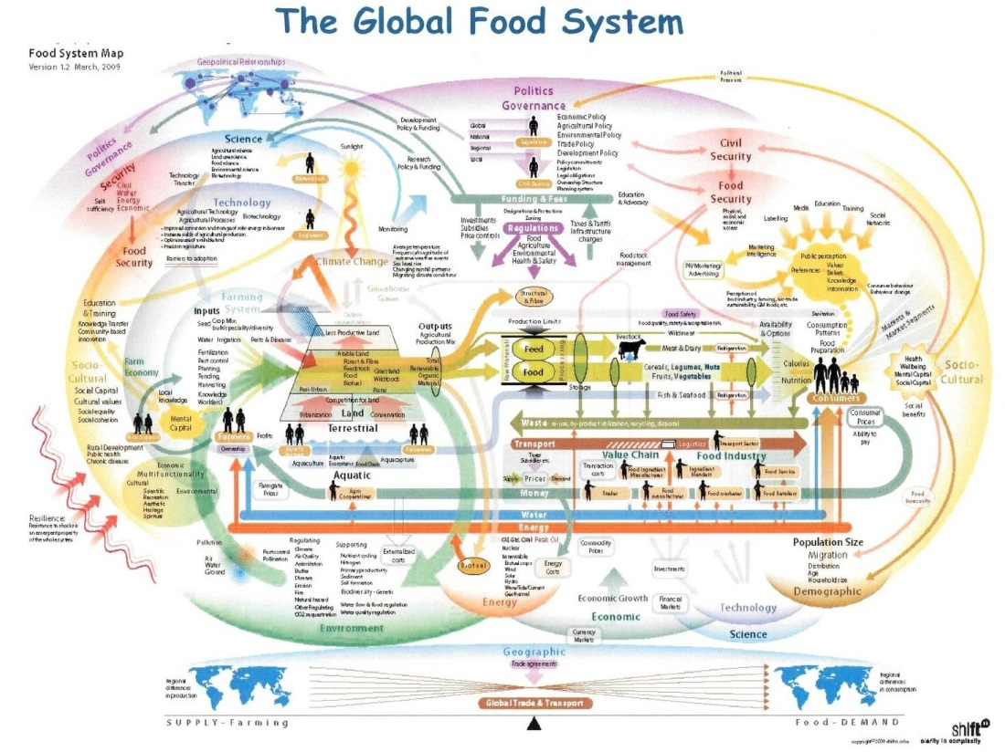
Systems are Dynamic
National Sustainability Teachers’ Academy

Slide 2
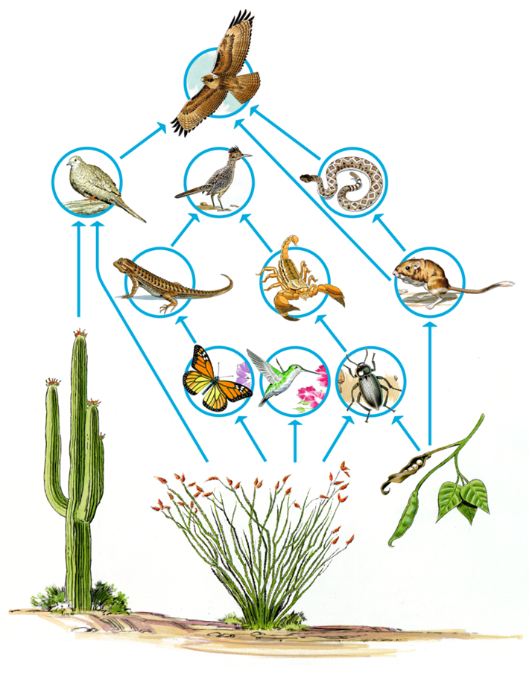
What is a SYSTEM?
What are defining features of a system?
Notes:
Think about a computer as a system—what happens if you move the mouse? Your direct action is on the mouse but what about the indirect change to the system when you click on the mouse?

Slide 3
Systems
Any combination of two or more components that have direct and indirect effects on one another is termed a “system.”
Systems have:
Boundaries
Components
Flows & Interactions
Notes:
Models should be realistic and based on data from the real world; they should be both explanatory and predictive. In some cases, they can be based on numbers and mathematical equations. Models should also represent ideas that fit into a larger framework of understanding.

Slide 4
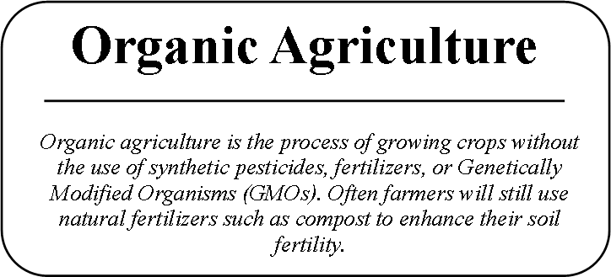
What about our food system?
Find your primary concept on the front of your card

Slide 5
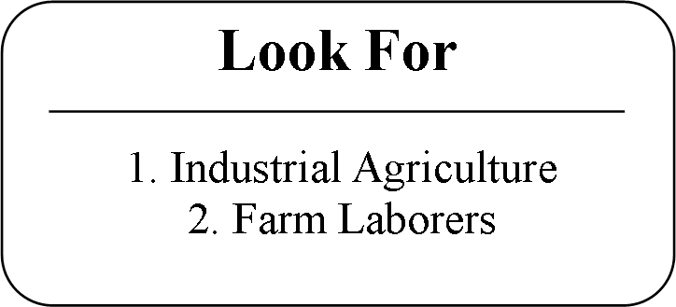
What about our food system?
Look for your two Interconnected Concepts on the back

Slide 6
What about our food system?
No matter what happens, stay equidistant to your Interconnected Concepts
X
X
Notes:
Demonstrate with 3 volunteers

Slide 7
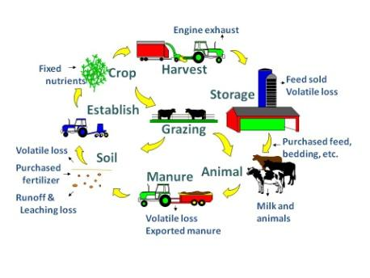
Food Systems: Elaboration
Where was your attention focused during the activity?
How did one ‘disturbance’ impact the entire system?
Why is it helpful to understand system dynamics and interconnectedness?

Slide 8
Food Systems: Evaluation
Reflect upon the relationship amongst the three concepts on your card. How do they impact one another?
As we saw a change in one area impacts the entire system, so what could you, as a consumer, do to positively impact the food system?
Lesson plan is on your USB drive & a version with additional worksheets can be found here: https://sustainableschools.asu.edu/learn-more/toolkit/food/

