Slide 1
Energy Innovations - Carbon Reduction & Energy Saving Opportunities
Presented by:
Robert Vandling, CEM, CRM, CDSM
Manager of Energy Efficiency
Arizona State University

Slide 2
Introduction
ASU’s Energy Innovations Group
Founded in 2015
Mission:
Acquisition of renewable energy and generation assets
On-Campus energy efficiency initiatives & upgrades
Innovative campus energy management projects
Achieve ASU’s Climate Neutrality Goals

Slide 3
Introduction
ASU’s Energy Innovations Group
Works with experts in the energy field, including ASU researchers, governmental entities, think tanks, utilities, ESCO’s and private industry. In conjunction with senior management, Facilities and University Sustainability Practices, Energy Innovations provides strategic direction and tactical support necessary to achieve ASU’s climate neutrality goals by 2025 and 2035.

Slide 4
ASU Climate Neutrality
2025 Goal – Climate neutrality for Scope 1 and Scope 2 Emissions
Scope 1 includes onsite use of utilities, such as Natural Gas and Oil, refrigerants, agriculture and vehicle fleet
Scope 2 includes purchased utilities, such as electricity and chilled water
2035 Goal – Climate neutrality for Scope 3
Scope 3 includes other carbon emitting sources, such directly finance air & ground travel, commuting, solid waste, waste water, paper purchases, etc.
Currently, ASU’s Carbon Inventory is at roughly 267,511 MTCO2e

Slide 5
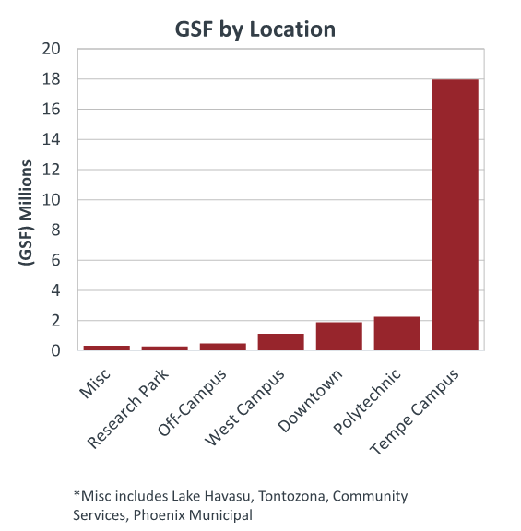
ASU Climate Neutrality
Total Building Space
- 24,361,313 sqft (FY18)
Total Number of Students:
- Over 100,000

Slide 6
Energy Innovations
Two sides to reach Climate Neutrality:
Supply Side
Changing the purchase of energy to zero carbon emission sources
Demand Side
Addressing and implementing energy savings strategies and the point of consumption

Slide 7
Energy Innovations
Supply Side
Campus Solarization
Co-Generation (CHP)
Micro-Grid
Battery & Thermal Storage
BioGas
New and upcoming technologies & energy sources

Slide 8
Energy Innovations
Demand Side
Building retrofits
Mechanical, Lighting, Plug Loads
Central Plant & Building Optimization
Updated control sequences and operations
Energy Services Performance Contracts
Demand Response
New and upcoming technologies

Slide 9
Supply Side

Slide 10
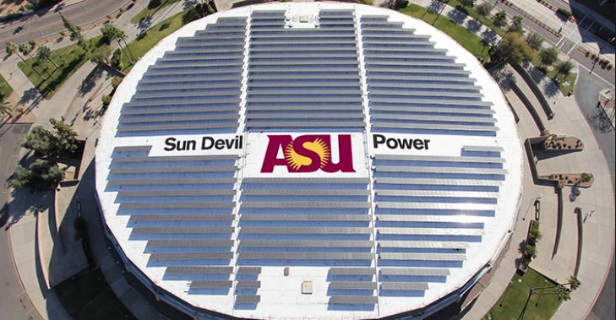
Supply Side
1) Solar
Total Production:
52.9 MWdc equivalent
FY18 – 104,616,266 kWh
30% of ASU’s total kWh load
Offset ~ 50,000 MTCO2e
91 systems
81 PV systems
4 solar thermal systems
3 thin film systems
2 CPV
1 Offsite PV (Red Rock)

Slide 11
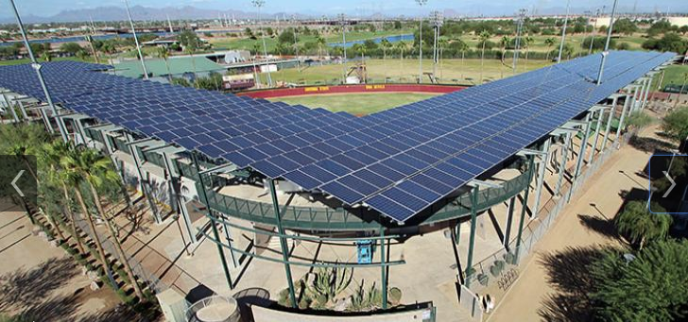
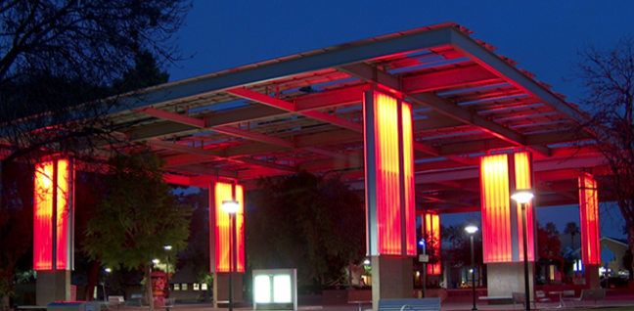
Supply Side
OnSite
24.1 MWdc equivalent
FY18 – 39,616,262 kWh
90 Systems
82,456 panels
8,652 CPV modules
7,840 Solar Thermal collectors
5,952 shaded parking spaces
828 shaded stadium seats

Slide 12
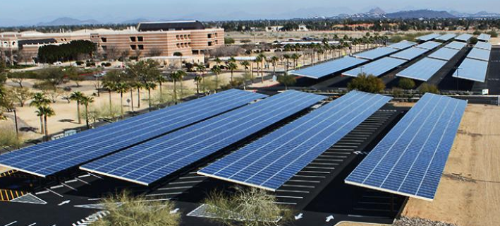
Supply Side
OnSite continued…
ASU owns 10 systems
81 systems are structured under a Power Purchase Agreement (PPA)
3rd Party ownership of the solar system
ASU buys the power produced from the system
Additional information:
https://cfo.asu.edu/solar
Generation data:
Campus Metabolism: https://cm.asu.edu

Slide 13
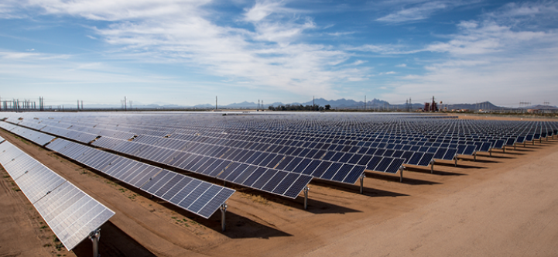
Supply Side
OffSite
ASU Red Rock Solar Project
A collaboration between ASU and APS in which APS constructed and operates a solar generating facility
Joint venture with ASU & PayPal
Commissioned January, 2017
28.8 MWdc
FY18 – 65,000,004 kWh
91,440 panels

Slide 14
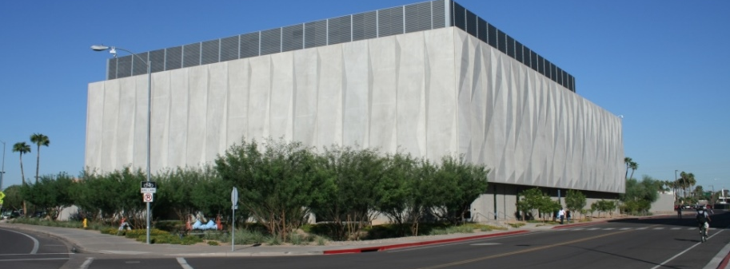
Supply Side
2) Co-Generation
Natural Gas fed 8.9 MW Generator
6.9MW Solar Turbine
* ”Solar” is the name of the turbine company
2MW Steam Turbine
Dedicated electrical generation for ASU Research Facilities
Bio A
Bio B
Bio C
ISTB 1
ISTB 4
CHP

Slide 15
Supply Side
OnSite electrical generation is also used to make chilled water
Five 2000 Ton York Chillers located in CHP
Waste heat is used to make steam for campus heating
Currently adding a second 8.9 MW Generator
6.9MW Solar Turbine
2MW Steam Turbine
Additional waste heat will be used for cooling (absorption chillers) and additional steam generators

Slide 16
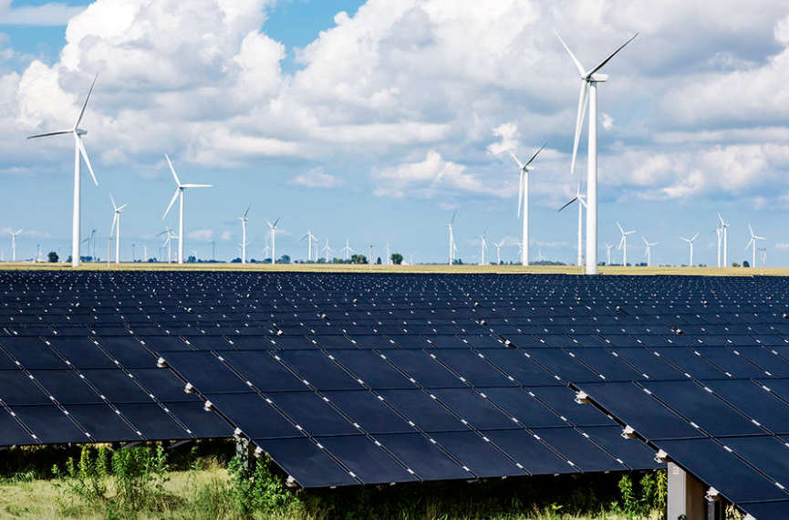
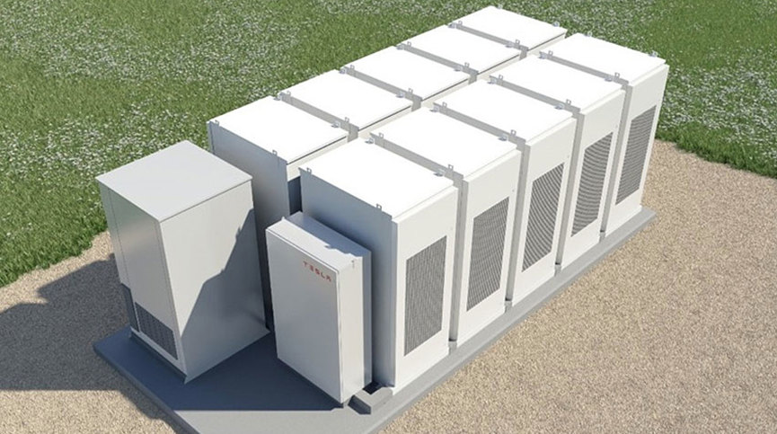
Supply Side
3) Future supply options
Battery Storage
Next “BIG” Renewable investment
RFP award

Slide 17
Demand Side

Slide 18
Demand Side
Building Demand
In order to minimize our investment into renewables, ASU needs to make sure it’s buildings are running as efficiently as possible.
To date, the Energy Innovations group has achieved the following results by reducing building energy consumption:
kWh saved annually: 17,636,180 kWh / year
Dollars saved annually: $1,606,410 / year
Metric Tons CO2e saved: ~8,000 MTCO2e / year

Slide 19
Demand Side
Steps for building evaluation:
Calculate a building’s Energy Use Intensity (EUI)
Review building metering and trend analysis
ASU’s Energy Information System (Campus Metabolism)
Building Automation Systems
On-Site Building Evaluations
Treasure Hunts
ASHRAE Level 1,2,3 Audits

Slide 20
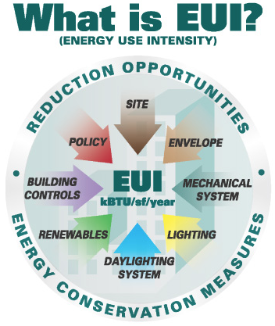
Demand Side
1) Energy Use Intensity (EUI)
The lower the EUI, the better
It’s calculated by dividing the total energy consumed by the building in one year (measured in kBTU) by the total gross floor area of the building.
Utilities evaluated include Electric Usage, Natural Gas, and/or Chilled Water and Steam usage if connected to a District Cooling/Heating system

Slide 21
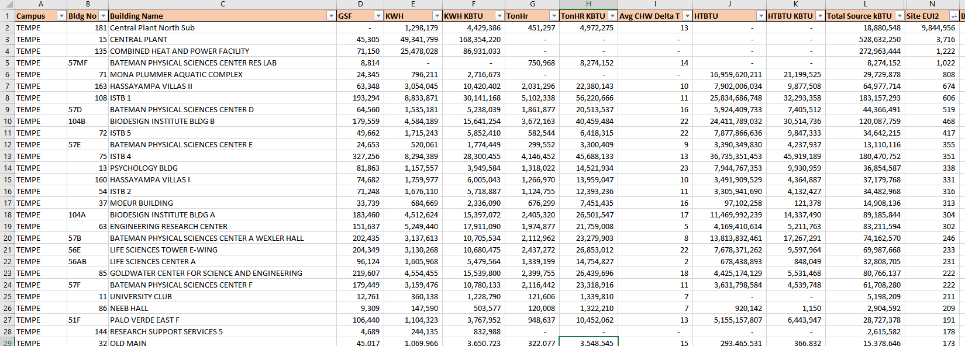
Demand Side

Slide 22
Demand Side
2) Metering & Trend Analysis
ASU meters the electrical, chilled water and heating usage of most of its buildings
Data is collected in 1min intervals in ASU’s Energy Information System (Also in Campus Metabolism)
Any data needed that is not in the EIS can be requested from the local utility
Identify opportunities from data and graph irregularities

Slide 23
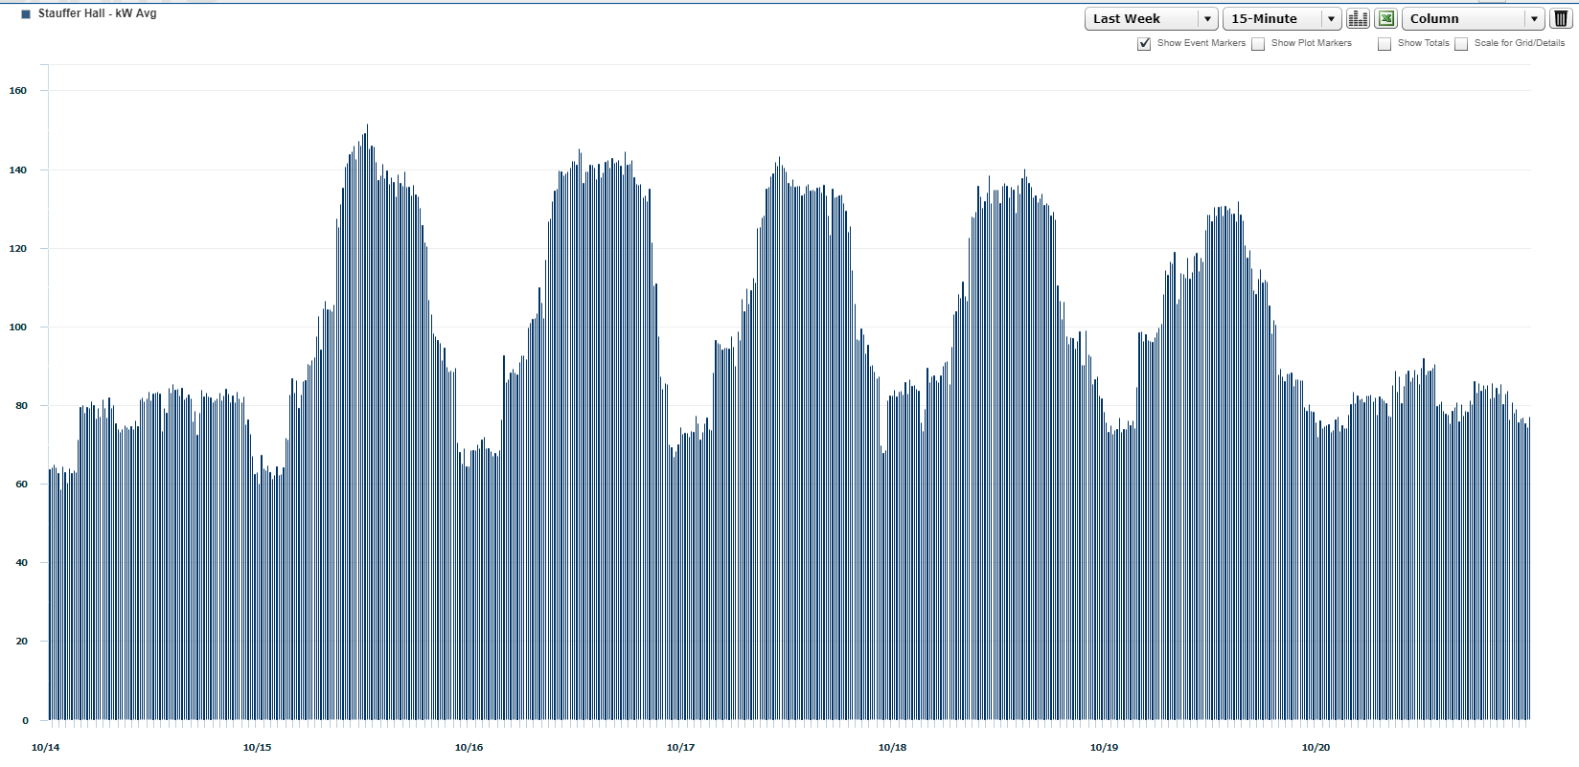
Demand Side

Slide 24
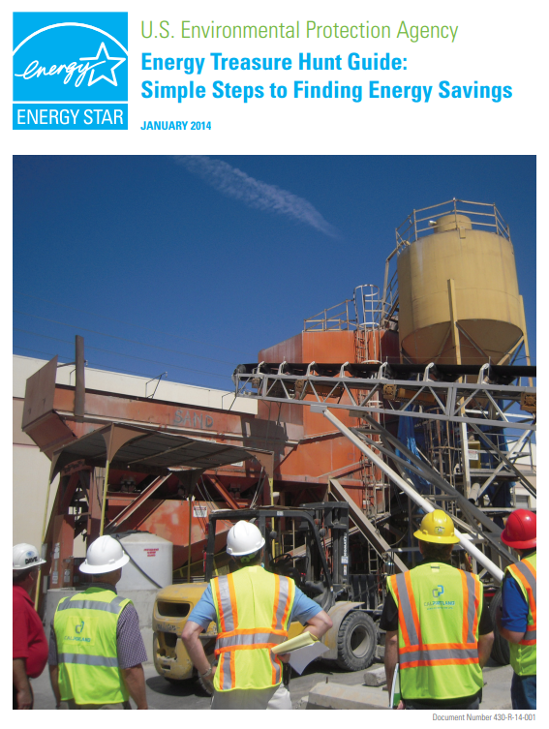
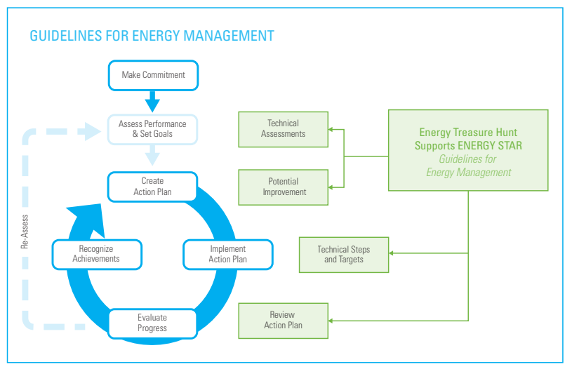
Demand Side
3a) On-Site Evaluations
- Employee Engaged Treasure Hunts

Slide 25
Demand Side
3b) On-Site Evaluations
ASHRAE Energy Audits
Level 1 – Walk-Through Analysis / Preliminary Audit
Physical evaluation and inspection of opportunities
Level 2 – Energy Survey and Analysis
Level 1 + Evaluation of billing and meter data
Estimated costs and savings of potential ECMs
Level 3 – Investment Grade Audit (IGA)
Level 1 and 2 + Additional onsite metering, energy calculations and modeling
Firm costs and savings for actual ECMs

Slide 26
Energy Conservation Measures
Lighting/LED Upgrades
Occupancy Sensors & controls
DDC Retrofits (Pneumatic to DDC)
Remove air compressors
DDC Sequence improvements
DDC repairs (Actuators, VAVs, etc.)
CHW / HW Valves
3-way valves to 2-way valves
Energy Valves or PICV
VFD’s (Pumps, AHU’s, Chillers, etc.)
EC Motors / Motor Sizing
Pumps
AHU’s
Etc.
Smart Motors
Fan Walls
Duct sealing
Notched belts and new sheaves
Use of Economizers
Displacement Ventilation Systems
Indirect Evaporative Cooling
Climate Wizard
VRF (VRV)
Fan Walls
Chilled Beams
Plasma in the airstream (Ionization)
Outside air setback
Building Envelope
Window Film
Dynamic Glass
Insulation
Roofing
Phase Change Material (PCM)
DX Coatings – renew coils, solar rejection/
Steam Traps
Water Fixture Upgrades – Low Flow
Building Optimization – BuildingIQ?
Continuous Commissioning
Fault Detection and Diagnostics
Renewables – i.e. Solar?
eTemp (
Fume Hoods – Constant Volume to Variable
Run-Around Loops on outside air intake
Efficient Chiller Upgrades / Replacements
Boiler efficiency
Exhaust fans
VFD
Modulating vanes
Sequences
Etc…

Slide 27
Demand Side Partners
Trane
McKinstry
Climatec
Ameresco
Honeywell
Wendel
JCI
McCarthy
Wilson Electric
Siemens
Various Engineering Firms
SolarThermix
PermaFrost
Hitatchi

Slide 28
SIRF
Sustainability
Initiatives
Revolving
Fund

Slide 29
SIRF
Tier 1:
Smaller projects that are designed to build a campus sustainability culture and promote student engagement. A small funding pool is set aside each year to award grants of up to $5,000, and is overseen by the director of Sustainability Practices at ASU and SIRF committee member.
Tier 2:
Medium-scale, capital-improvement initiatives that return a project’s costs within 6 years or less. These loans are ideal for departments that need to upgrade or renovate space and equipment to improve efficiency and reduce carbon emissions, and require that the department match-fund the proposed investment as well as share in the return generated.
Tier 3:
All large-scale initiatives that make a significant and measurable sustainability impact and return a project’s costs within 10 years or less. These loans are targeted at strategic internal and external partnerships that reduce carbon emissions.
https://cfo.asu.edu/sirf

Slide 30
SIRF
Funded from ASU’s General Utility Fund
Tier 2 & Tier 3 Projects are evaluated only on energy savings
O&M and Life Cycle Costs are not considered
Project Requirements
NPV >$10,000
IRR >8.0%
Simple Payback:
5 years or less for projects under $500k
10 years or less for projects over $500k
https://cfo.asu.edu/sirf

Slide 31
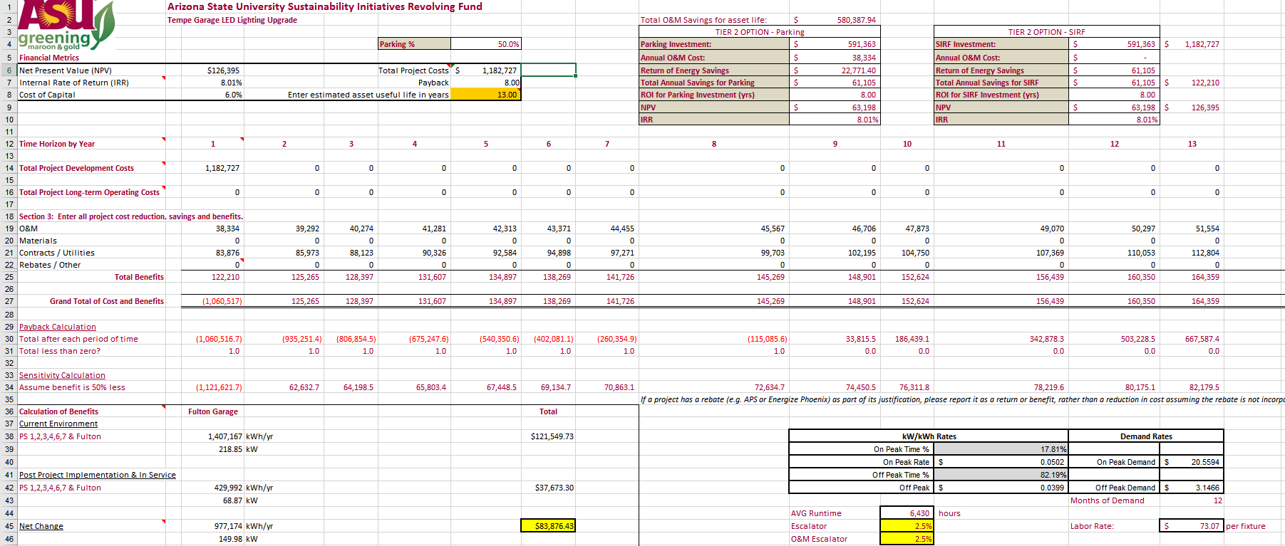
SIRF
https://cfo.asu.edu/sirf

Slide 32
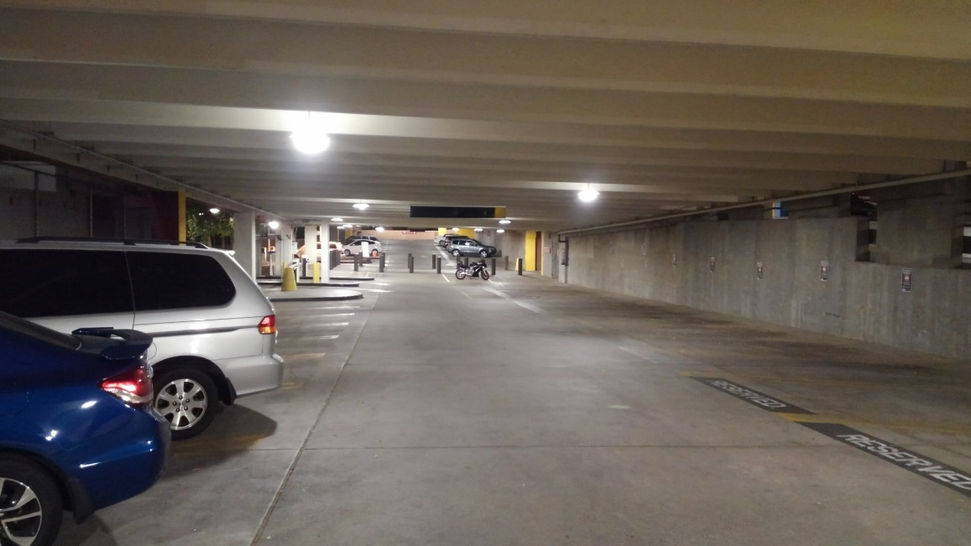
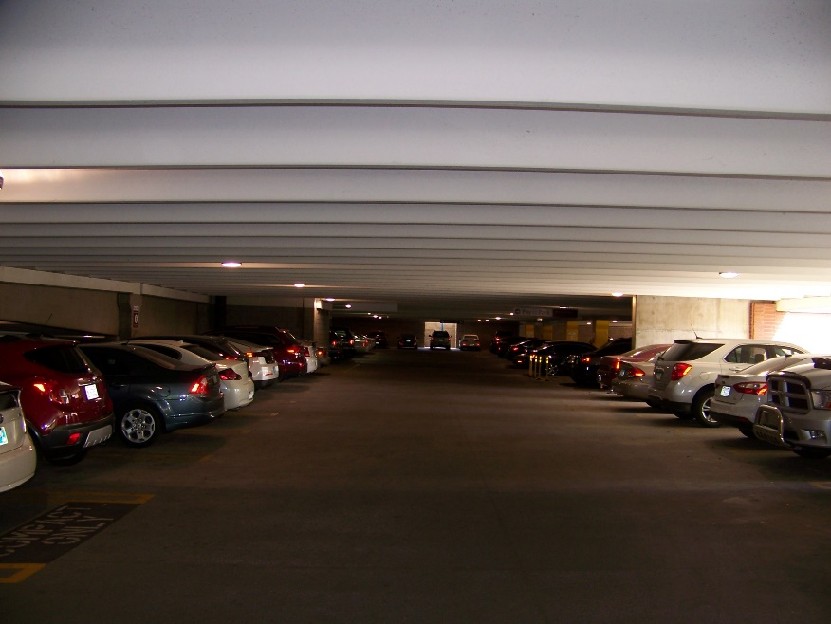
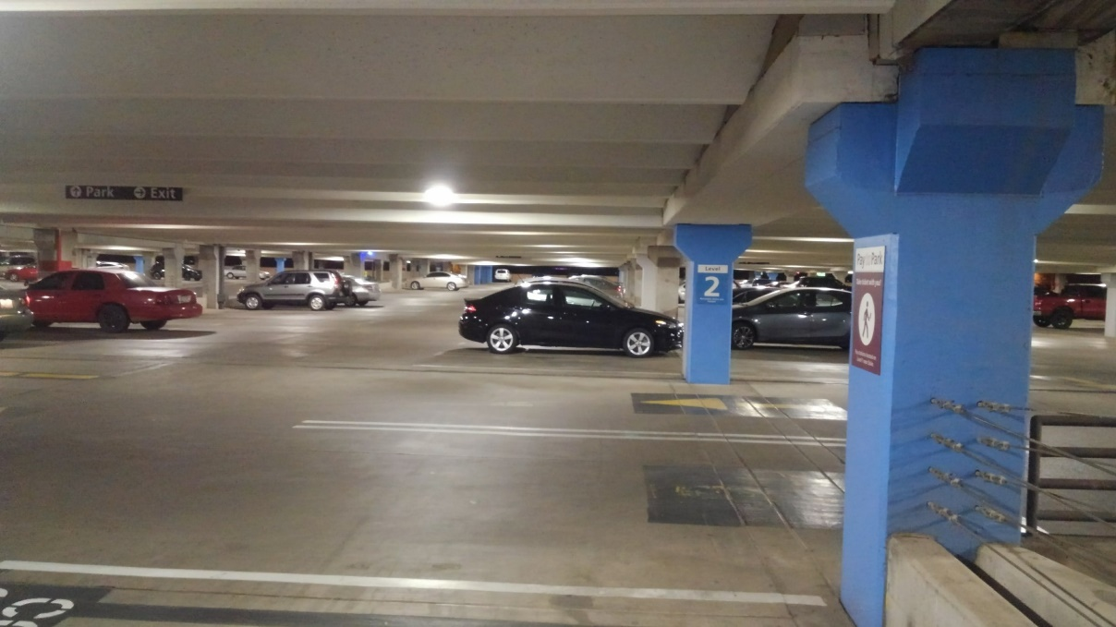
Projects
AFTER
BEFORE

Slide 33
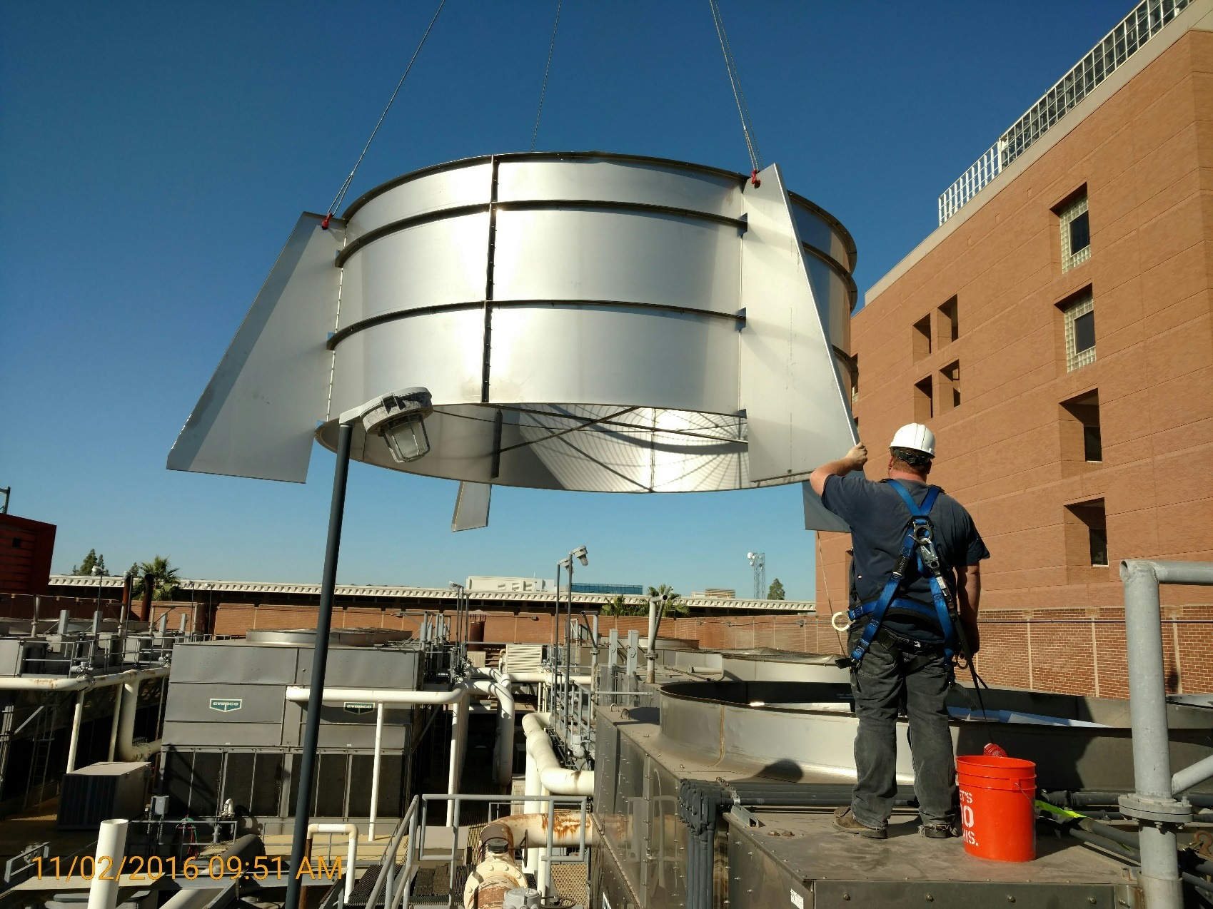
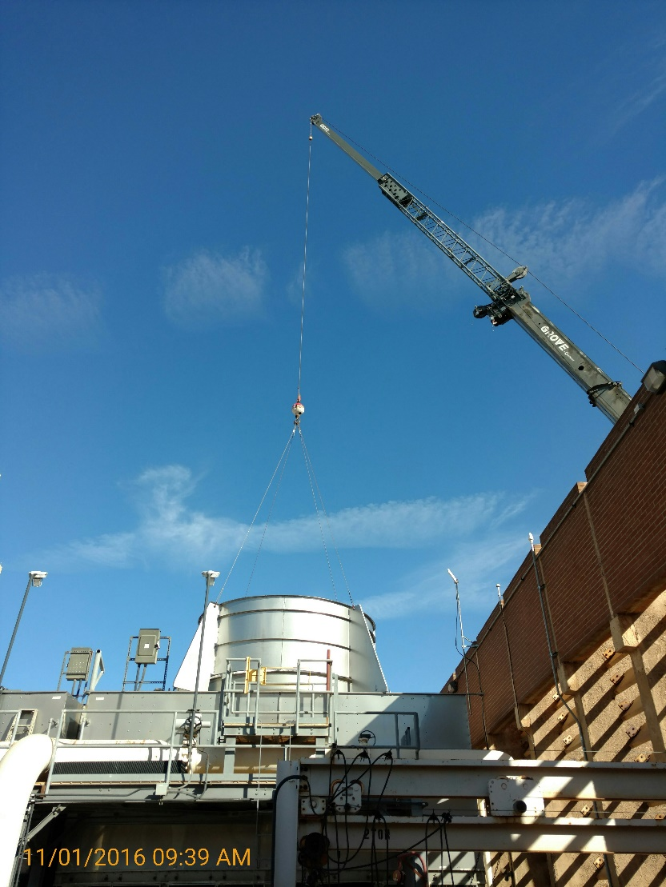
Projects

Slide 34
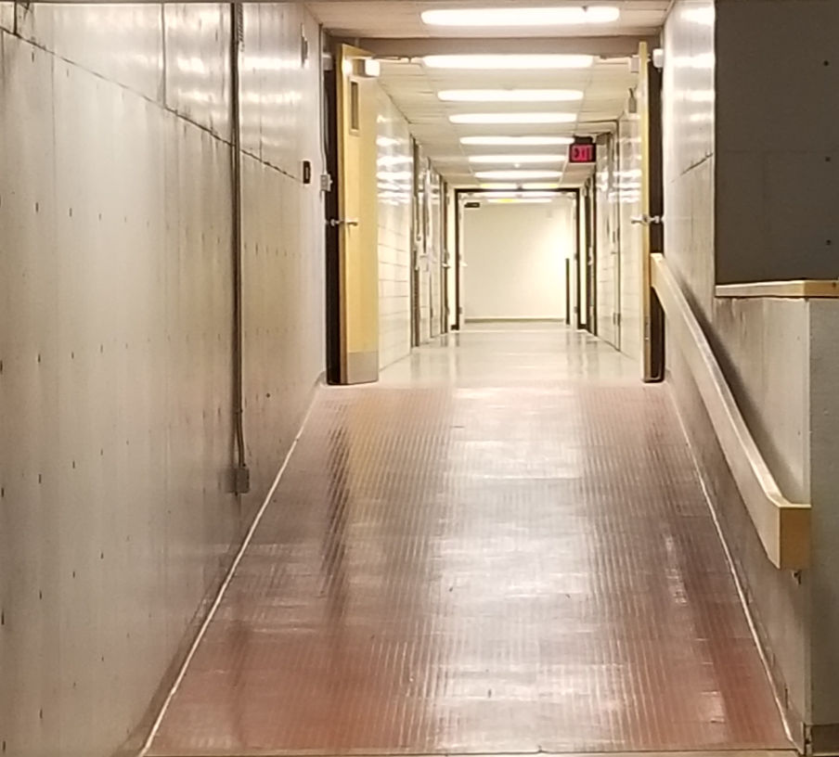
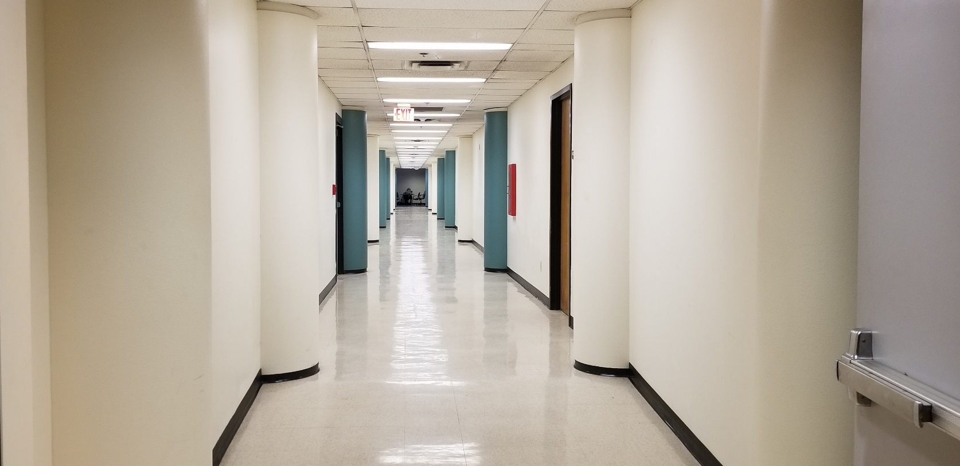
Projects
AFTER
LED Lighting, 4000k
Physical Science H Wing
BEFORE
Fluorescent Lighting, 3500k
Physical Science E Wing

Slide 35
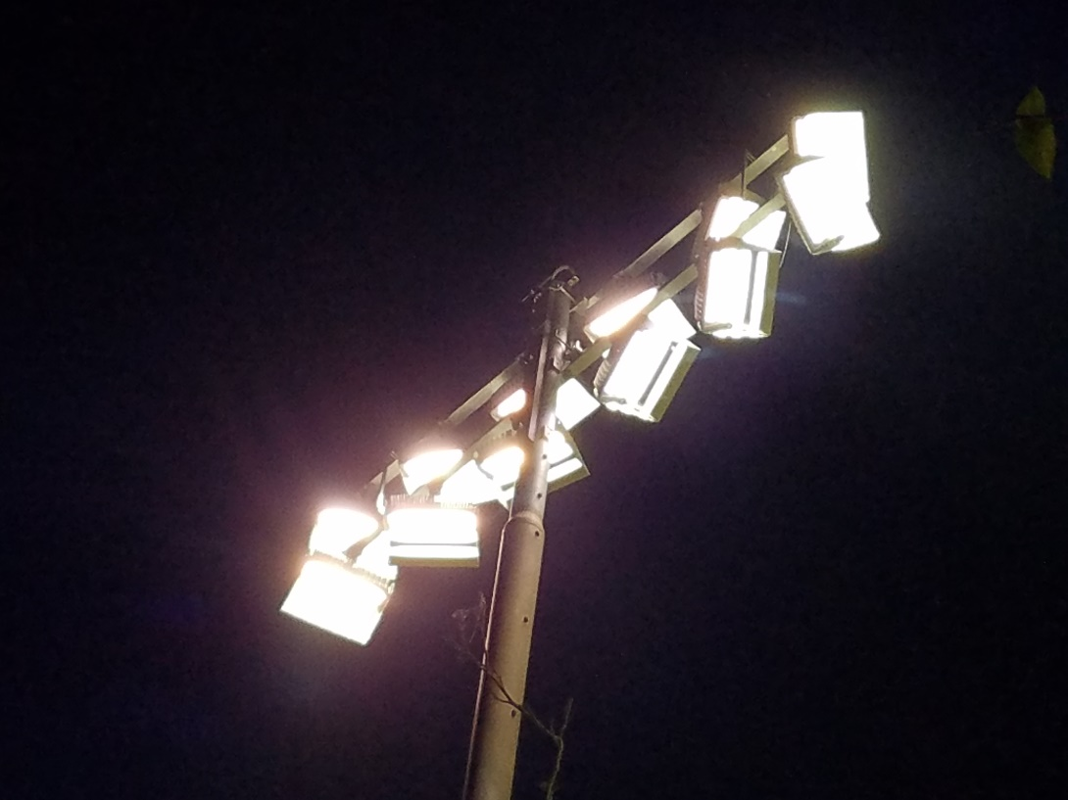
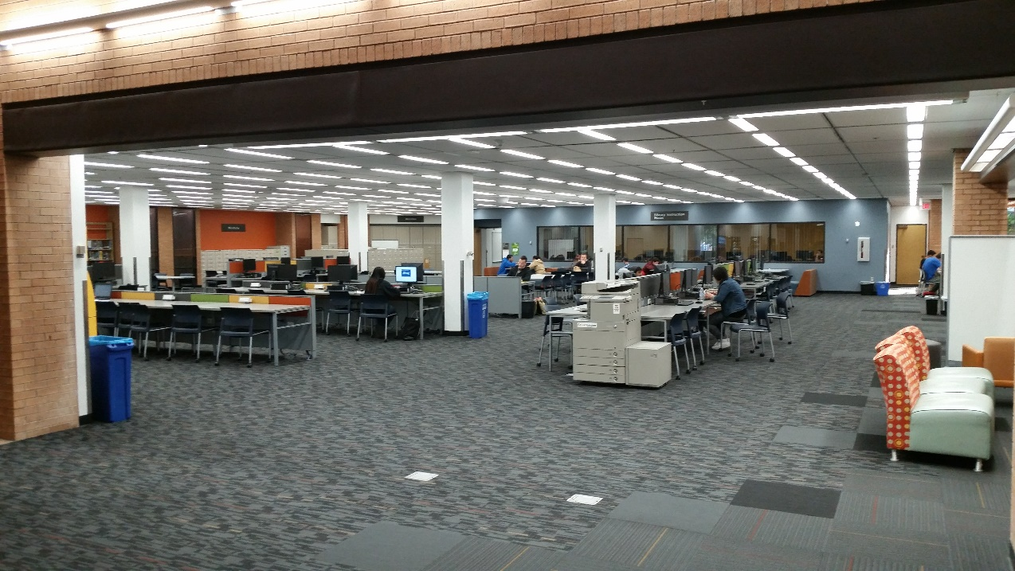
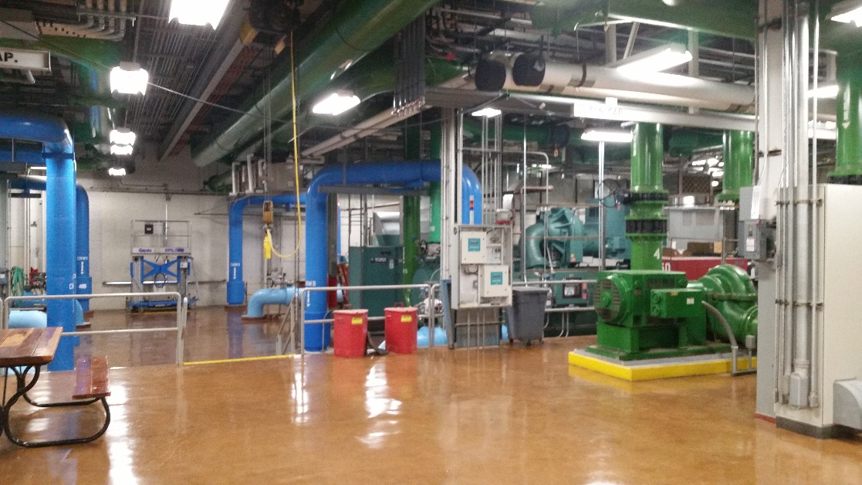
Projects

Slide 36
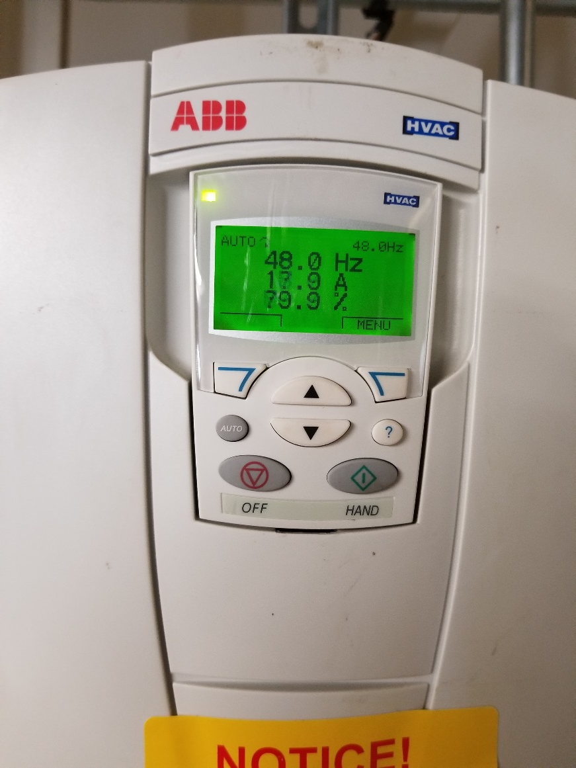
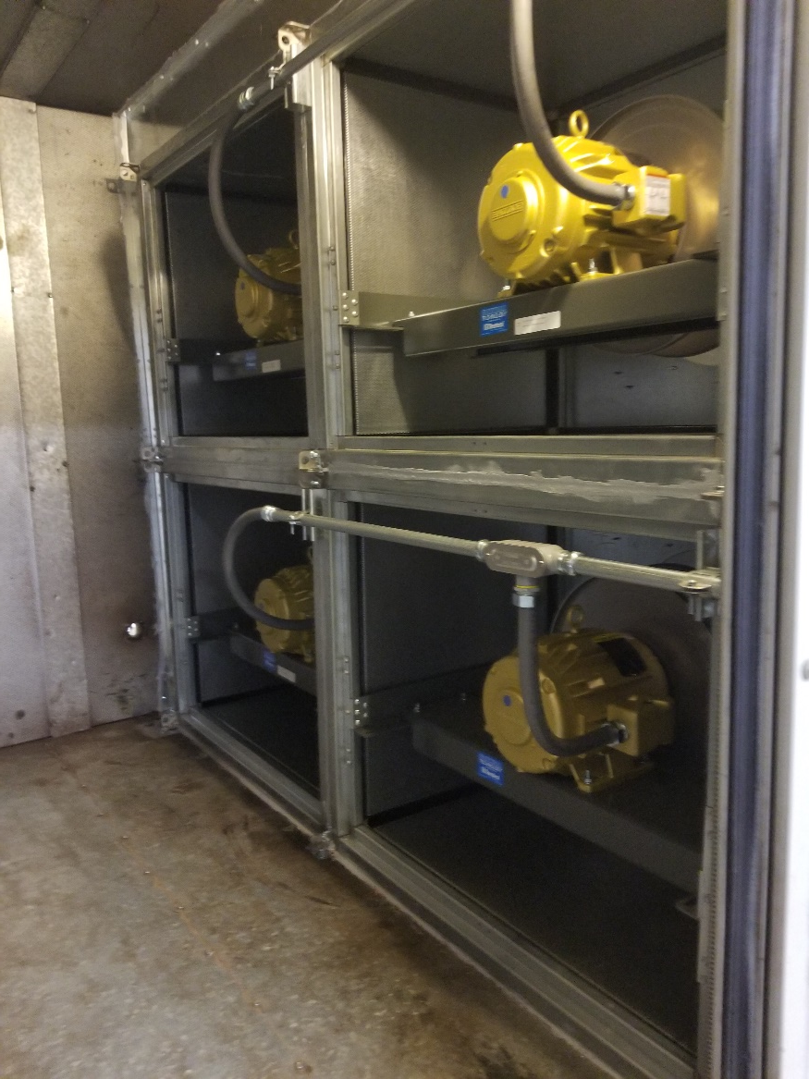
Projects

Slide 37
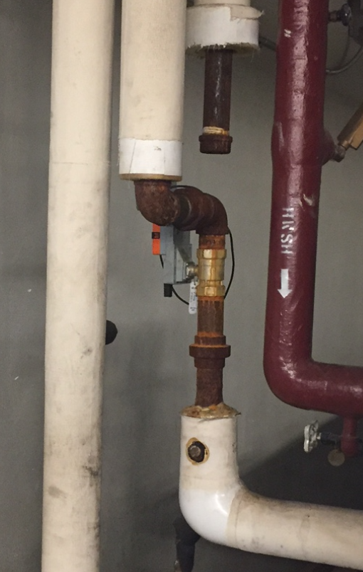
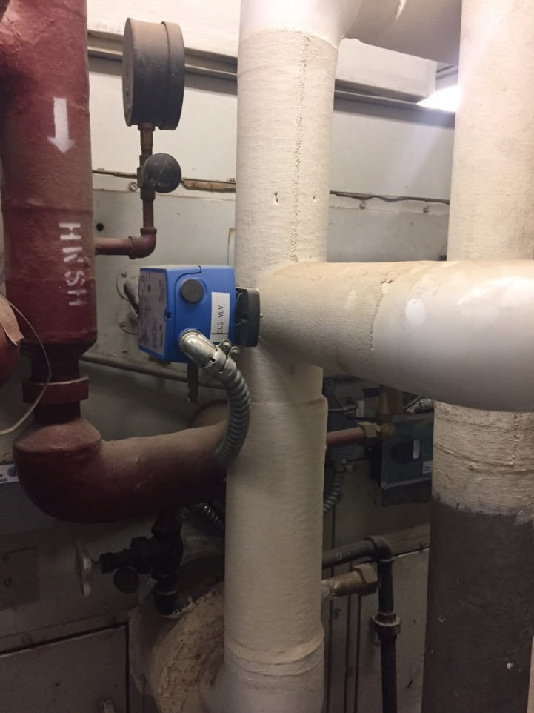
Projects
New 2-Way Belimo Energy Valve
Old 3-way valve

Slide 38
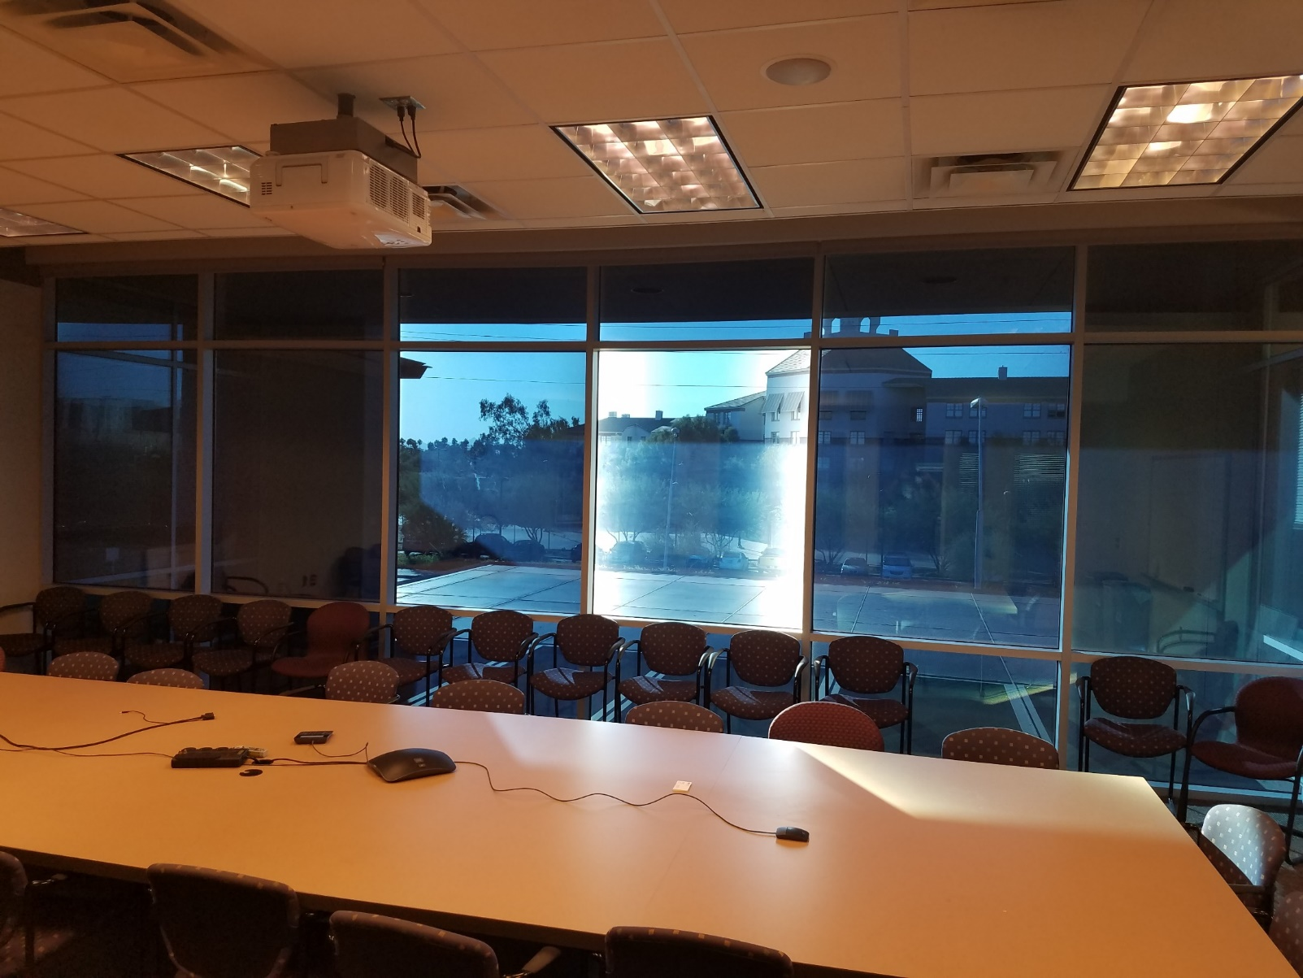
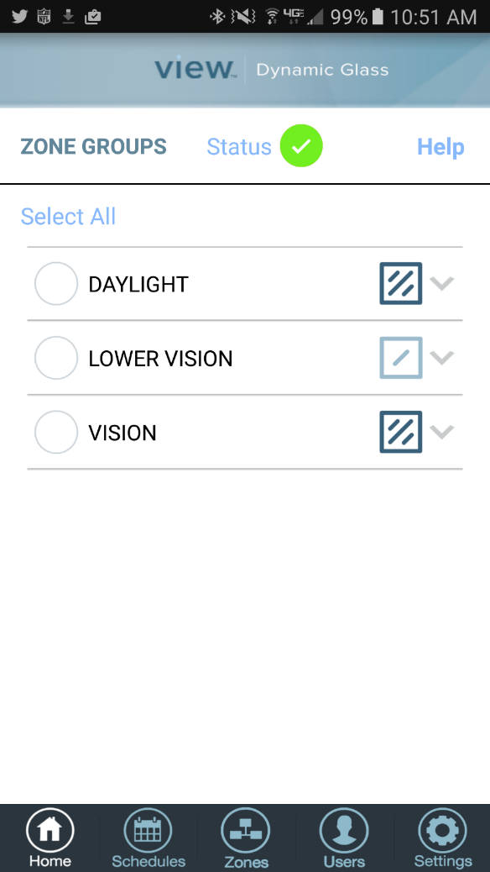
Projects

Slide 39
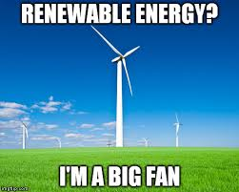
Questions?

